Slide 1
Columbia Engineering Data Analytics Boot camp Project I
Date: 6/17/2024
Karen Lin, Kevin Zhang, Sunjae Youm

Slide 2
AGENDA
Introduction
Data Processing
Analysis
Data exploring
ROCKVILLE dataset
Speed Limit
Traffic control
Weather & surface condition
Hourly intervals
Timeseries
Conclusion

Slide 3
Introduction
Background
Our data team assumed that we received a data request from the Montgomery County local government in Maryland. The purpose of the request was to determine how to use the county budget to reduce car accidents. Additionally, Montgomery County wanted to choose a specific municipality and asked us, as data analysts, to identify which roads need immediate improvements. To achieve this, we investigated traffic accident records from January 2015 to March 2024, analyzing the main car crash accident factors and variables from the dataset.
Data Source:
https://catalog.data.gov/dataset/crash-reporting-drivers-data/resource/9851a37f-4f32-464e-8ba6-c23023653a7f

Slide 4
Questions
Q1. How can we identify the area with the highest frequency of car crashes?
Q2. Which factors in the dataset should we prioritize to effectively reduce car accidents?
Q3. What insightful patterns can we uncover from the dataset?

Slide 5
Data processing

Slide 6
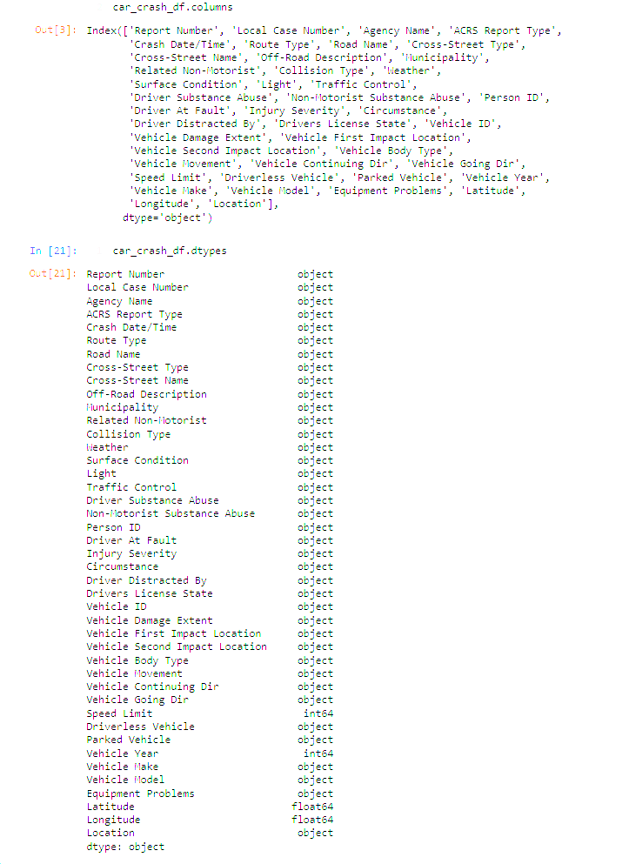
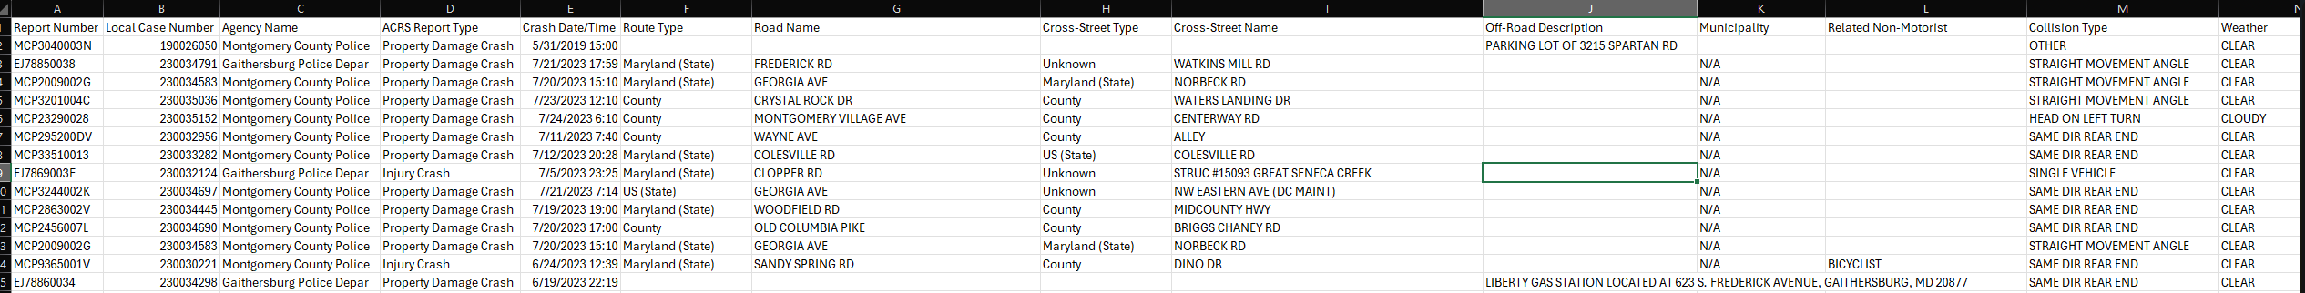
Data exploring – raw data
Raw Data Summary
No quantitative data
43 columns
Car crash date/time is in the same cell

Slide 7
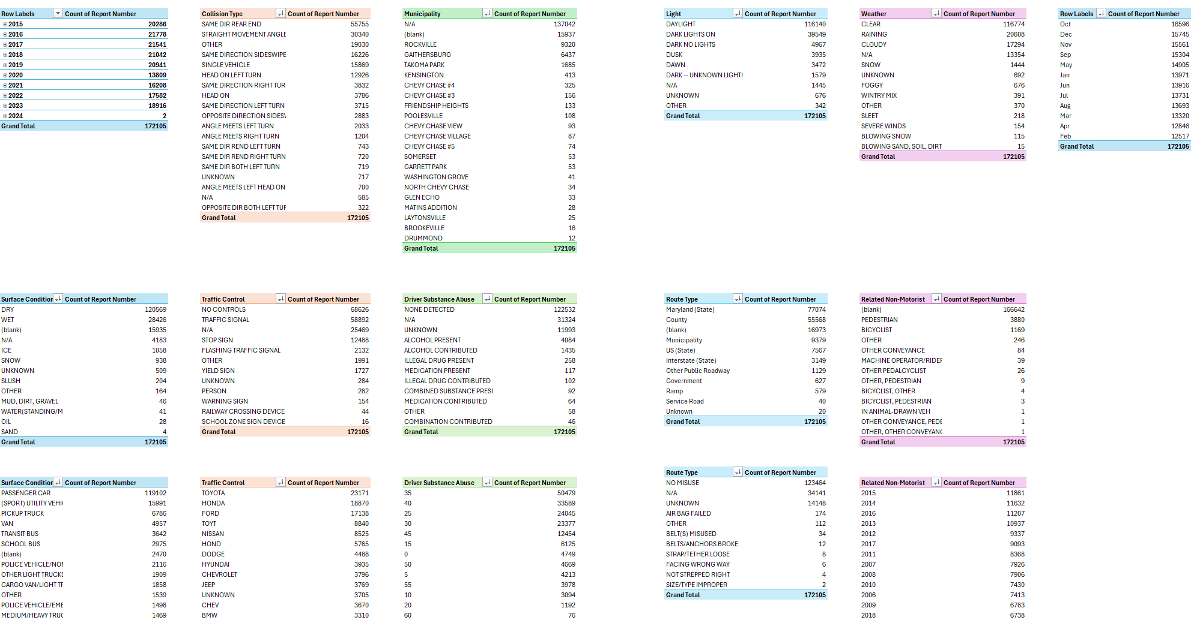
Data exploring – a multiple pivot tables

Slide 8
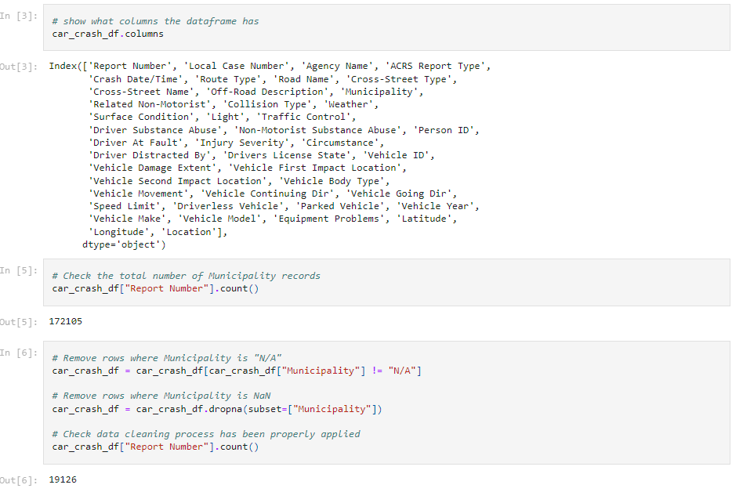
Data Cleaning – Removed Not available rows

Slide 9
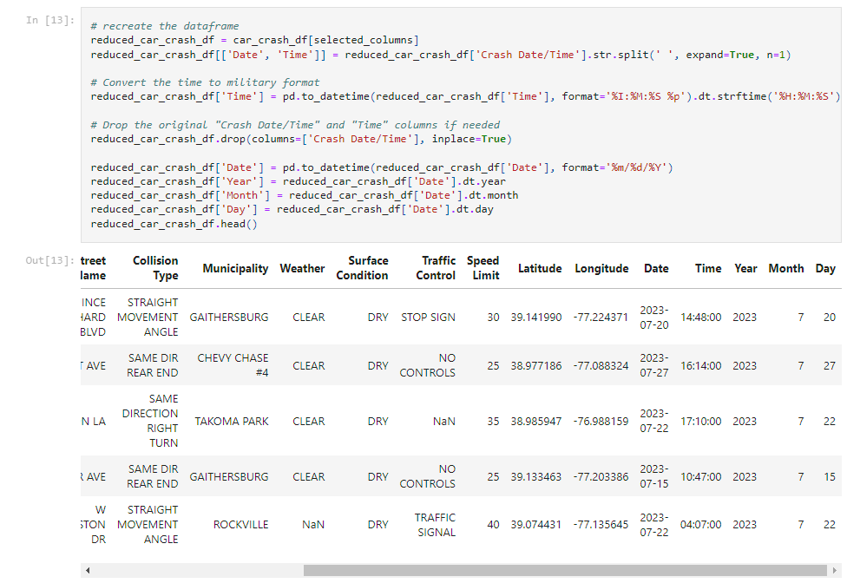
Data transformation

Slide 10
analysis

Slide 11
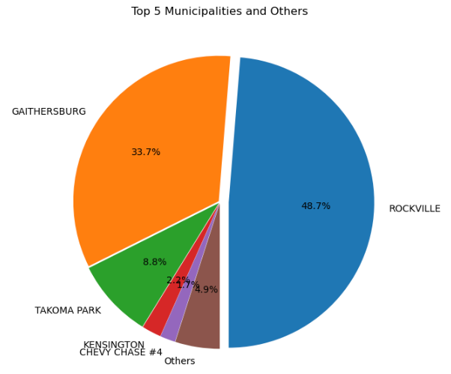
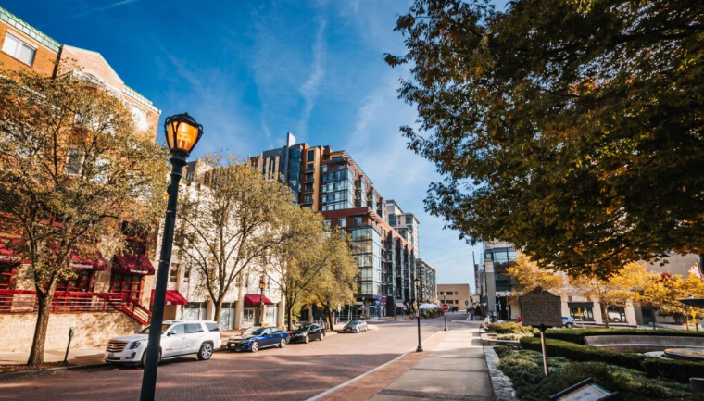
Exploring data
- ROCKVILLE Municipality has the highest number of car accidents in Montgomery county

Slide 12
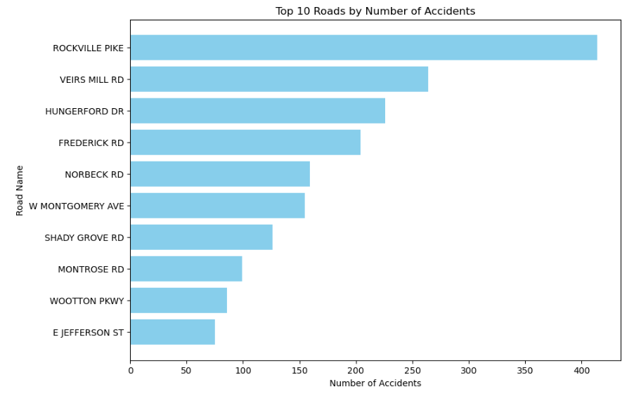
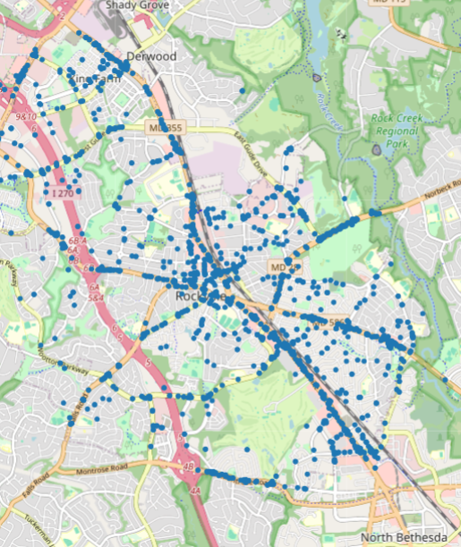
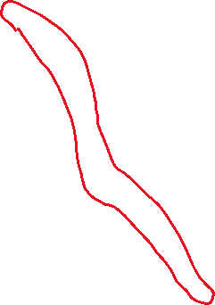
Exploring Data
Used Latitude and Longitude in the dataset to draw the map plot to see where the car accidents most happen
Aggregated the number of car crash accidents by road name in Rockville Municipality

Slide 13
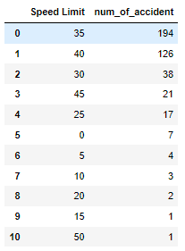
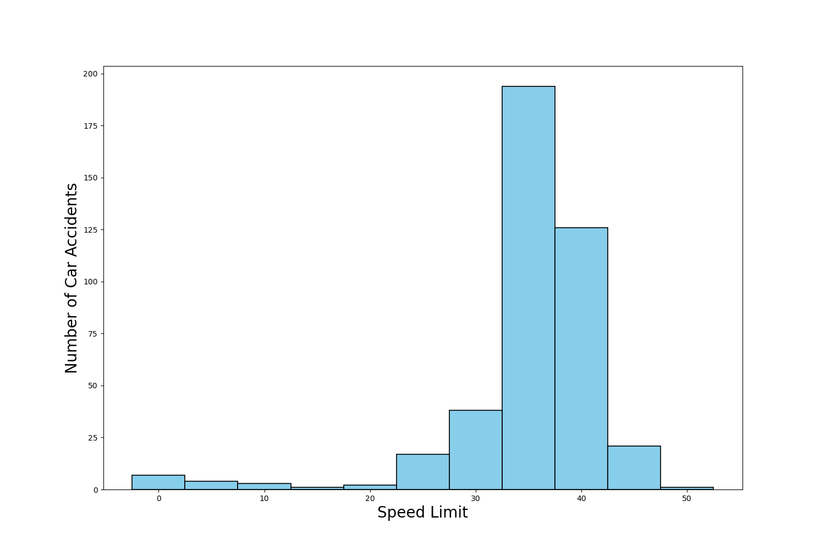
Rockville data set – by speed limit
Observations:
- 80% of the number of accidents were occurred between 35 and 40 limit.
Recommendations:
- For car accidents that occur on roads with speed limit 35 and 40 mph, One suggestion is to reduce the speed limit, but further study needs to be done to see which roads the accidents occurred, to tailor the response and take into account congestion times.

Slide 14
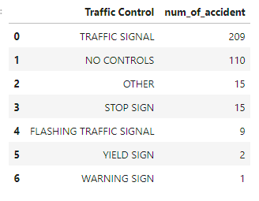
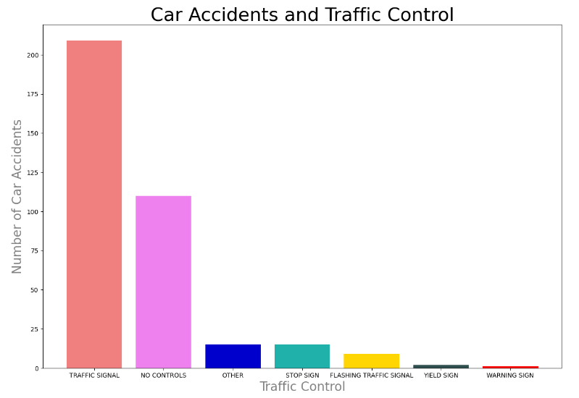
Rockville data set – by Traffic control
Observations:
- Car accident near Traffic Signal was the number one reason among other traffic controls
Recommendations:
- The road has higher speed limit and normally drivers get into the car accident when they try to pass the yellow light. With that said, shorting the yellow light time would help improve the number of car accident

Slide 15
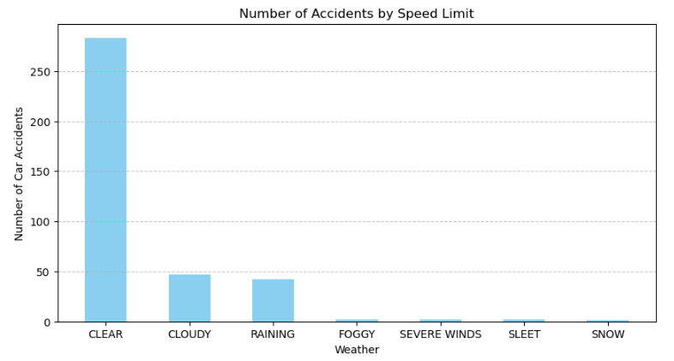
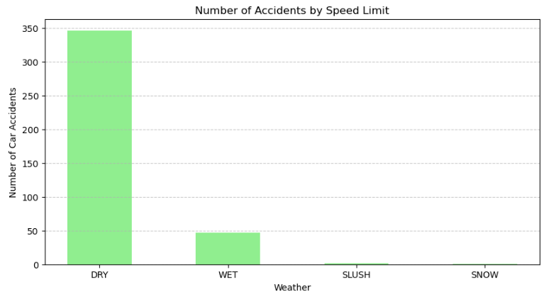
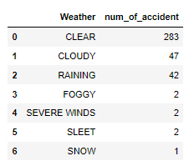
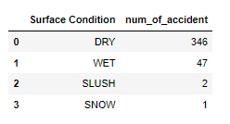
Rockville data set – by weather & surface condition
Observations:
- Can’t find any correlation with the number of car accidents

Slide 16
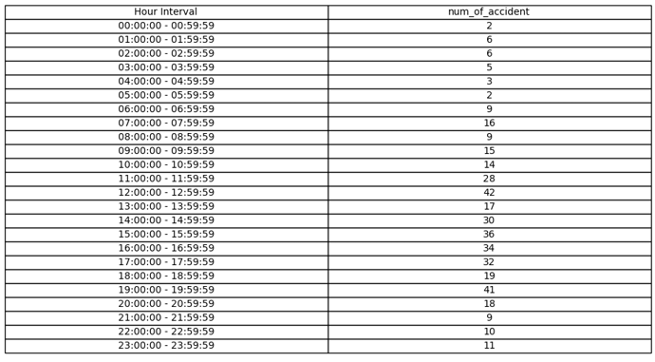
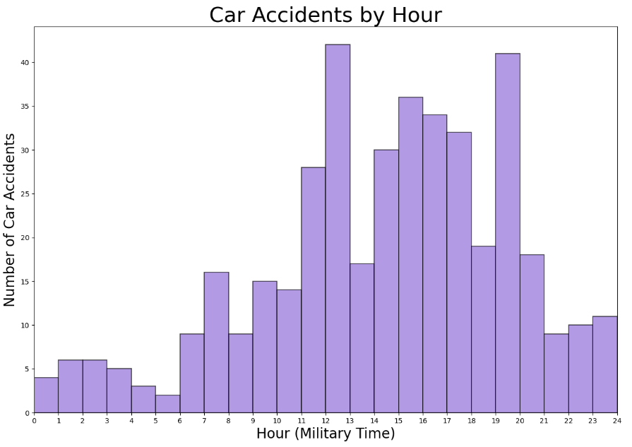
Rockville data set – by Hourly Intervals
Observations:
- The number of car accidents were higher than another hour interval at between "12:00 PM and 1:00PM", "02:00PM and "06:00PM" and "07:00 PM and 08:00PM".
Recommendations:
- Place more traffic polices on the ROCKVILLE PIKE on the time intervals have the most car accidents

Slide 17
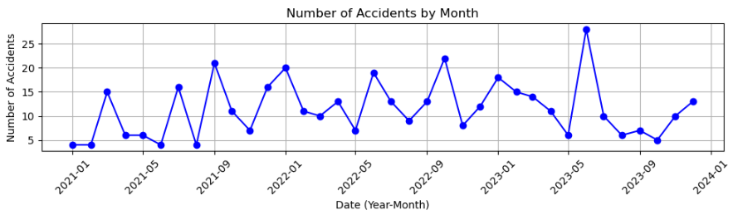
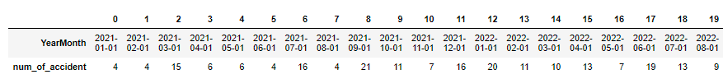
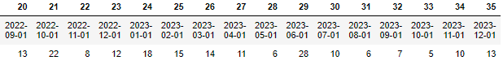
Rockville data set – time series
Observations:
Every year June had high increase of car accidents
Research shows that the traffic congestion is getting higher due to the increase of population (https://empowermontgomery.com/transit-power/)
Recommendations:
- Expand the highway right next to Rockville Pike or put more traffic police in June to control the traffic

Slide 18
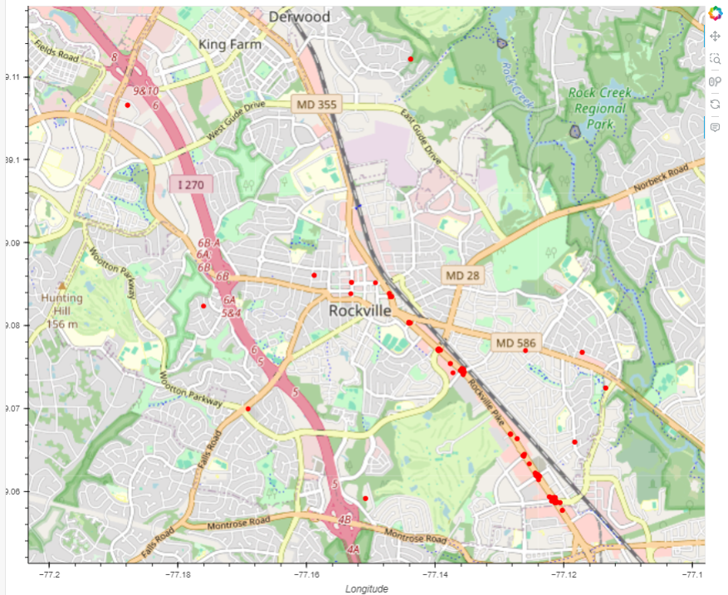


conclusion
With the two data perspectives Speed Limit and Traffic Signal, we could narrow down to the final recommendation
Based upon the filters (speed limit & traffic signal), 155 records could be collected
Final Recommendation for this analysis is lower the speed limit on the spotted area in the map or control traffic signal light

Slide 19
THANK YOU

